Slide 1


WELCOME TO THE PeArson ORIENTATION ( NEW STUDENTS) OCTOBER 2022
CENTER # 91929

Slide 2

What Are we Looking at : *Why Choose BTEC Higher Nationals –HTU differentiators. * FAQ * Assessment Process and Grading (Student Guide) * Awarded Programmes * Create HNGlobal Account https//hnglobal.Highernationals.com https//www.htu.edujo/Pearson/index.html * Key Templates * Student Voice ( Annual Student Survey) * Centre Support materials and resources

Slide 3
WHY CHOOSE BTEC HN
BECAUSE
It provides LEARNING OUTCOMES (LO) based curriculum
Project based and coursework assignments
It provides HANDS-ON Experience for future careers
It is an opportunity for Learning by Doing
It is to become JOB-READY, A Passport to Employment
It meets the requirements of the Modern World Industries
It is a Kick-Start for young peoples careers, building Employability skills
Robust Quality Assurance Measures & Internal verification
APMR + Annual Student Survey
Annual BTEC AWARDS

Slide 4
ENGAGING WITH THE EMPLOYERS
Awarding Body PEARSON
Design Qualification to Meet identified skills and competences
Provider HTU
EMPLOYERS

Slide 5




Slide 6
WHAT MAKES HTU DIFFERENT?
HOW MANY CERTIFICATES CAN I GET FROM HTU?
HOW MANY TIMES CAN I BE ABSENT FROM CLASSES ?
WHAT HAPPENS IF I SUBMIT MY ASSIGNMENT LATE?
HOW MANY TIMES CAN I RESUBMIT A COURSE ?
HOW MANY TIMES CAN I REPEAT A COURSE?
WHAT HAPPENS IF I FAIL A PEARSON COURSE TWICE?
What is the Highest Grade after Resubmission or Re-take
IS APPRENTICESHIP MANDATORY? WHAT ARE THE BENEFITS?
WHO CAN I TALK TO IF I HAVE A PROBLEM ?
WHY ARE FOUNDATION COURSES IMPORTANT ?
ARE THERE OPPORTUNITIES FOR TRAVEL ?
Can I seek further degreed overseas after HND’s ( Degree Finder platform)
WHAT IS HNGLOBAL ?- https://hnglobal.highernationals.com/

Slide 7

This Student Guide and support videos are available at:
https://www.htu.edu.jo/Pearson/index.html

Slide 8
Approved Full Awards
BTEC HN (RQF)
Engineering
(GE+ME+EE)
Construction And The Built Environment
(Arch + Civil)
Computing
(CS+IS+Cyber Sec + DS)
HNC
8 UNITS L4
HND
8 UNITS L5
HTU BSc

Slide 9
What is a grade?
What is a grade?
It is a reflection of a student’s accumulative performance holistically
It is hierarchal: students have to achieve all pass, merit and distinction criteria across the UNIT as a whole to earn a distinction.
Pass
(LO example- Explain)
Merit
(LO example- Analyze)
Distinction
(LO example create/construct)

Slide 10
Grading Mechanism
Pass | Merit | Distinction
P1 | M1 | D1
P2 | M2 | D2
P3 | M3
P4 | M4
P5
5/5 need to be covered to score a P | 9/9 need to be covered to score an M | 12/12 need to be covered to score a D
* In case of scoring a U, a student can apply for a resubmission. After resubmission, the maximum grade the student can score is a P.

Slide 11
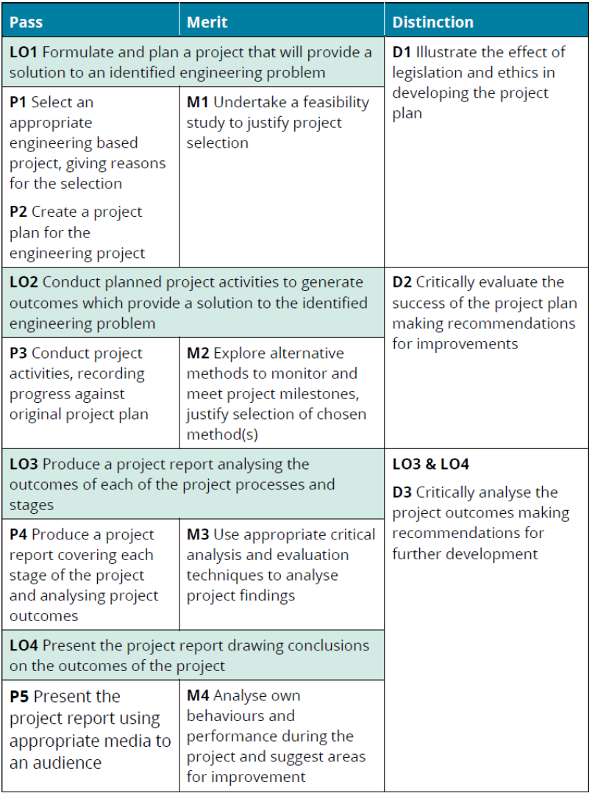
Sample assessment criteria
This is found at the end of each assignment. This particular assignment covers all learning outcomes.

Slide 12

Forms of Evidence for Assessment
Planning Documents
Case Studies
Project
Oral/Viva
Recorded Discussion
Reports
Performance
Peer Review
Log Books, Diaries, etc.
Written Investigation
Essay/Dissertation
Discussion Forum
Artefacts
Blog/e-Journal
Independent Research
Examination
Presentation Handouts, etc.
Role-play
Time-constrained Assessment
Work-based Learning
Witness Statements
Annotated Photographs
Self-reflection
Multiple Choice
Fill in the Blanks

Slide 13
( Key IV Templates) – For students
Assignment Brief
Scheme of Work (SOW)
Assignment Feedback
Student Declaration/Unit Repeat -On student Portal
Student Declaration - On student Portal
Student Resubmission – On student Portal
Discontinue Unit form - On Student Portal
Authorized Extension(for late work)
Transfer Templates – on student Portal
Grade Appeal – On Student portal
FOLLOW
THE ACADEMIC CALENDAR

Slide 14
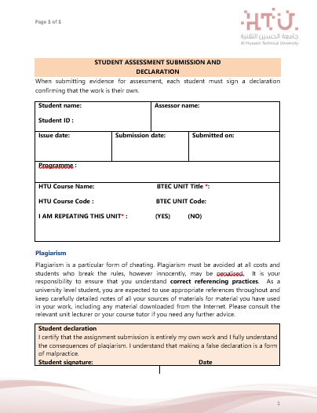
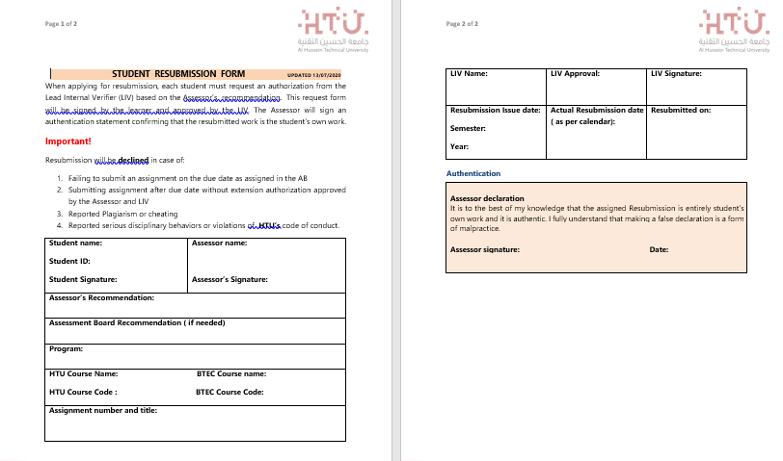

Slide 15

Formative feedback and assessments
As you are approaching the assignment date, instructors will arrange for formative feedback and assessments. These include:
Revision sessions;
Recorded instructional videos;
Practice quizzes;
Case studies;
All of these methods are used to fine-tune your performance and better equip you with the skills you need

Slide 16
Summative feedback & assessment
Summative assessment is the Final Consideration by an Assessor of a student's assignment, agreeing which assessment criteria the student has met in the assignment and recording those decisions.
Students are not offered opportunities to revisit assignments at this stage of the assessment process.

Slide 17
FOR SUPPORT AND GUIDANCE VISIT THE QULIATY ASSURANCE UNIT HTU-MAIN 2 (411)
Notes:
Using the handout, have the delegates work in subject-related groups to develop a vocational scenario for a unit of their choice. Have a couple of groups share their scenario and get the rest of the group to comment on its appropriateness. Does it give the student a clear role, at the appropriate level? Does it give a relevant and up-to-date context? Is the overall presented clearly?

Slide 18

QUESTIONS
FEEDBACK

Slide 19

Evolving and Overcoming Challenges

Slide 20

IT TAKES A VILLAGE AND A MIND SHIFT!!
Thank You

Slide 21

PRESENTATION 06/09/2022
12:30 pm

